Slide 1

Introduction to Information And Communication Technologies 24BSAI, First Semester, First Year
Introduction To Computers and Its Applications
Department of Software Engineering,
Mehran University of Engineering and Technology, Jamshoro

Slide 2
Importance Of Computer
Today, computers has become an important element in the life of the individual of all ages.
Computer helps us doing certain jobs in split seconds that the human even can’t think of it
Computer is an electronic device used in almost every field even where it is most unexpected. That is why this age is called as the era of IT. And now we cannot imagine a world without computers. ...
Computer has become very important nowadays because it is very much accurate, fast and can accomplish many tasks easily.

Slide 3
Importance Of Computer
The computers are becoming the fundamental part of every field like they are widely used in industries, banks, insurance companies, universities, colleges, nuclear science, weather forecasting, weapon designing, car modeling, air crash investigation, Bio-medical sciences etc. because they perform specific tasks very quickly and accurately.
Computers are also used in the medical industry to help doctors in diagnosing the diseases quickly and efficiently.
All the administrative systems, whether private or public are now using computers and this practice can be evident in every part of the world.

Slide 4
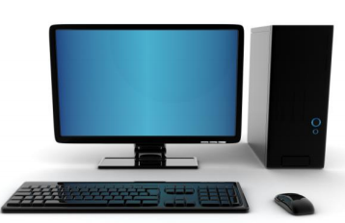
Computer Defined
Technically speaking, the term Computer doesn't have a full form. Nevertheless there is a hypothetical Full Form of COMPUTER, which is said to be Common Operating Machine Particularly Used for Trade, Education, and Research. Computer is essentially derived from the word 'compute', which basically means 'calculate'.
Computer is an electronic device, which is capable of:
Receiving the input
Processing the data on the basis of given set of instructions
Producing the output
Storing the information (if needed)

Slide 5
Introduction to computer
The computer is an electronic device, which is capable of receiving input, processing the data according to the given set of instructions, producing output and also capable of storing huge amount of data permanently.
Computer is so called an electronic device because a computer is simply a machine which operates on the electric signals.

Slide 6
Introduction to computer
There are many types of computers but the primary job of every computer is to convert raw data in to the useful information by applying some processing on the raw data according to the given set of instructions.
The computer receives the data from the user via input devices then it applies some processing on to it with the help of processing devices (processor) and converts it into useful information then it shows that output on the output devices (like monitor or printer) and if requested it stores that processed data (information) on to any storage media (like hard disk or floppy disk etc.) permanently so that it can be accessed by the user at any time.

Slide 7

Basic task of a computer
No matter what type or size of the computer is the basic task of any computer is to convert raw data (useless data) in to information (useful data).

Slide 8
Information Processing Cycle
As the basic task of a computer is to convert the raw data in to the useful information.
To do this task the computer performs a process called information processing cycle (also called data processing cycle), which is set of steps arranged in a particular manner.
Each step of this process requires one or more components of the computer.
Information processing cycle contains four steps:

Slide 9
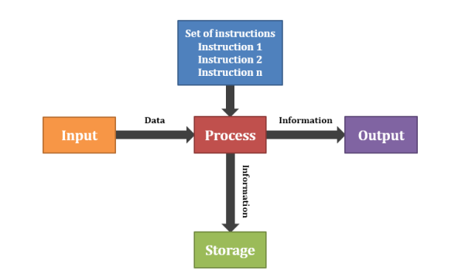
Information Processing Cycle

Slide 10
Information Processing Cycle
INPUT: During this step the computer accepts the input from the user via any input device like keyboard or mouse. It is very important step as the computer cannot do anything by itself so it needs the instructions in the form of input.
PROCESS: During this step the processing devices (Microprocessor) of the computer performs some processing on the inputted data according to the given set of instructions and converts the data in to information. The data processed by the processor in stored in memory (RAM) temporarily so that the processor can receive and access the data very fast. So in this step the two important devices of the computer RAM and Processor are used.
OUTPUT: During this process the computer shows the result of processed data on some sort of output devices like monitor or printer. It is very important for the computer to show the output because if the computer cannot show the result then how a people can come to know that data has been converted in to information.
STORAGE: During this step the computer permanently stores the processed data on any storage device like hard disk, floppy or USB. It is important to save your important data on the permanently storage media so that you can access that data again whenever you want, else you have to set the data again which will be itching and can be time consuming to write the data again and again.

Slide 11

Application Areas of Computer
Nowadays computers are considered backbone in many different fields.
1. Education :
Schools, Colleges, Universities

Slide 12
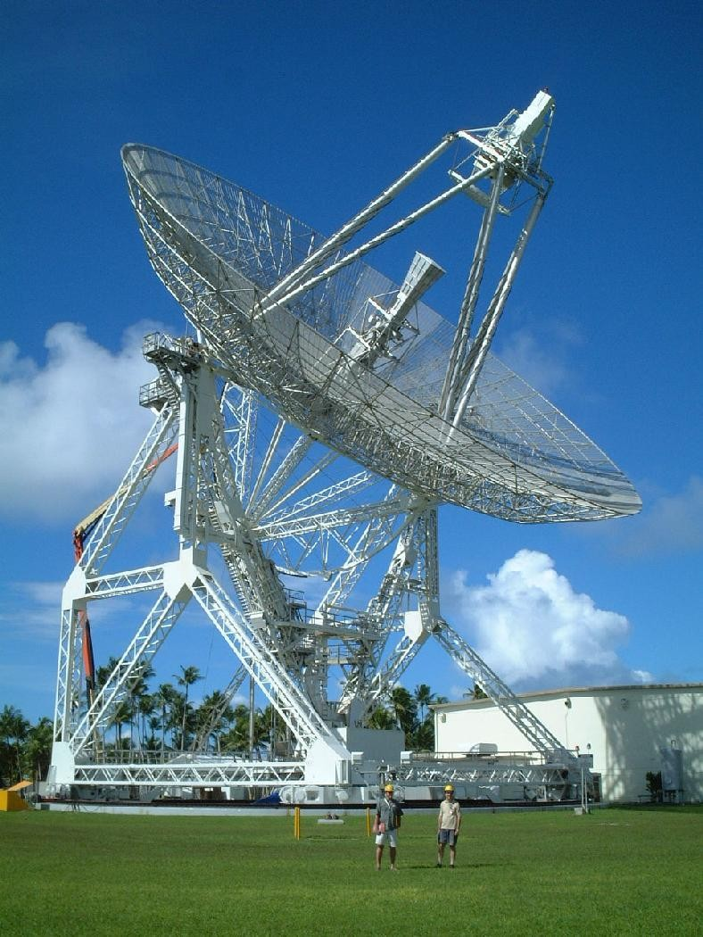
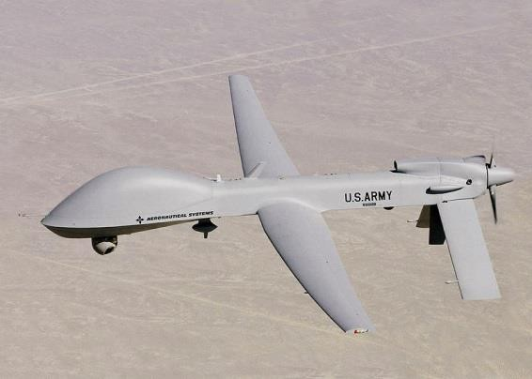
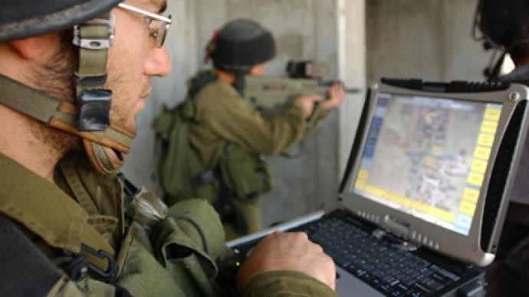
Application Areas of Computer
2. Military:
Missile launch, Trajectory, Radar, Satellite Communications

Slide 13
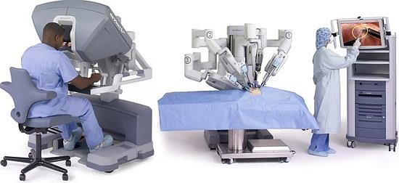
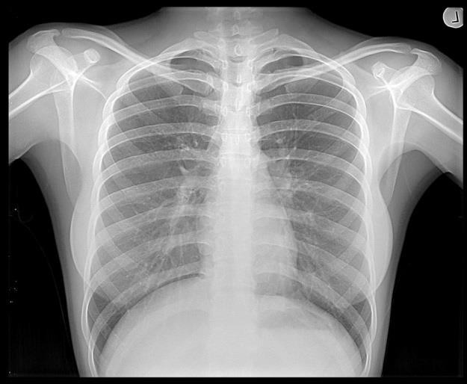
Application Areas of Computer
3. Medicine:
Surgery, Remote treatment, X-Ray, Ultrasound, CT Scan

Slide 14
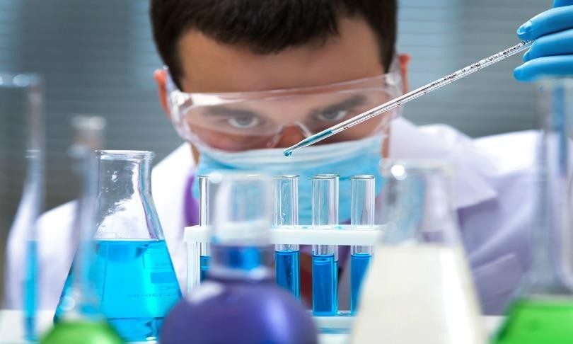

Application Areas of Computer
4. Research:
Simulators, Special Software, Surveys

Slide 15
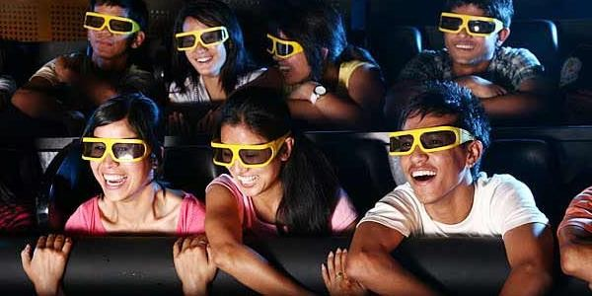
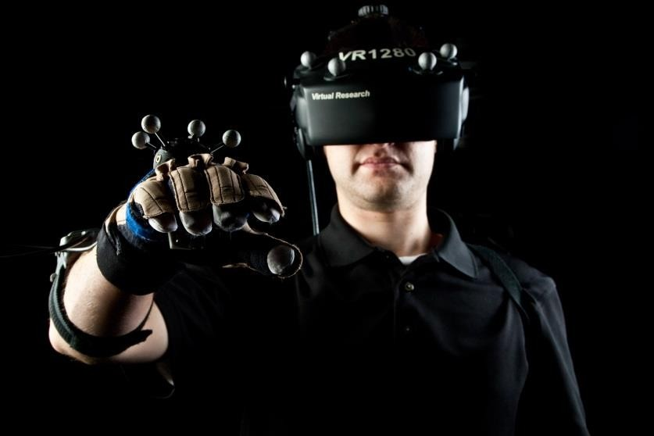

Application Areas of Computer
5. Entertainment:
Music, Movies, Games, 3D and 4D Cinemas, Virtual Reality

Slide 16

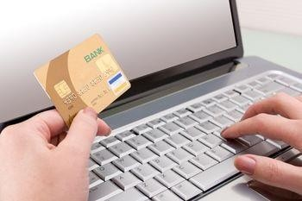
Application Areas of Computer
6. Business:
Banks, ATM, Online Banking, Online Shopping

Slide 17
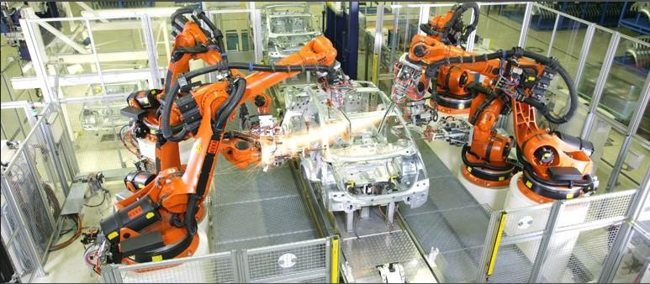
Application Areas of Computer
7. Industry:
Production, Painting, Robots, Engine construction

Slide 18
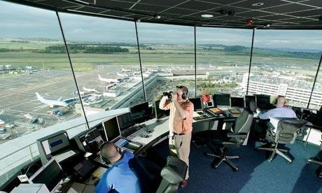

Application Areas of Computer
8. Transportation:
Airline, Train reservation, Air traffic control, Auto pilot
Notes:
An autopilot is a system used to control the trajectory of an aircraft without constant 'hands-on' control by a human operator being required. Autopilots do not replace human operators, but instead they assist them in controlling the aircraft. This allows them to focus on broader aspects of operations such as monitoring the trajectory, weather and systems

Slide 19
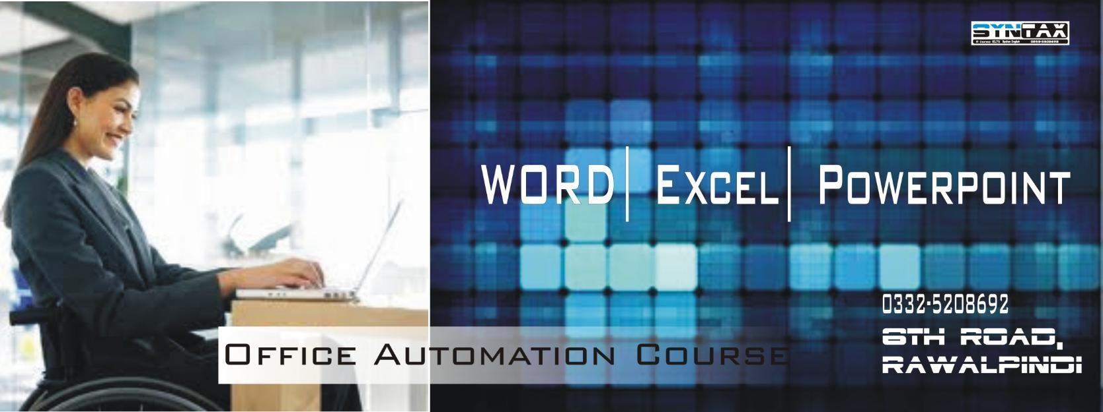
Application Areas of Computer
9. Office:
Office automation, email, MS Office
Office automation refers to the varied computer machinery and software used to digitally create, collect, store, manipulate, and relay office information needed for accomplishing basic tasks.

Slide 20
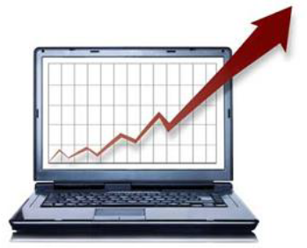
Application Areas of Computer
10. Marketing
Advertising, Home Shopping
Advertising - With computers, advertising professionals create art and graphics, write and revise copy, and print and disseminate ads with the goal of selling more products.
Home Shopping - Home shopping has been made possible through the use of computerized catalogues that provide access to product information and permit direct entry of orders to be filled by the customers.

